Slide 1
GEOGRAPHICAL PROFILING OF ROUTES BASED ON SECURITY AND SURVEILLANCE
PIP104 PROFESSIONAL PRACTICE-II
VIVA-VOCE
Batch Number: 18
20211LCC0002 20201CCS0066 20201CCS0127 20201CCS0135 | Tutika Keerthana Sai Akula E Reventh Vallishetti Anusha M.Srinivas Reddy
Under the supervision of:
Dr. Dakhole Dipali Khushalrao
Assistant Professor
School of Computer Science & Engineering
Presidency University

Slide 2
Introduction
• At present, in general tourists and travelers waste a lot of time planning and deciding their trips to achieve maximum satisfaction. In this context, this application aims to identify the main computing needs to support the improvement of tourist point of promotion for the traveler, by the means of an easy to use mobile application proposal.
• Normally, most travelers like to visit the safest spots as well as safest place to view. This system is basically used to help a traveler new to the city or anyone who wants to explore a city within a specific location. The user is supposed to enter his/her source and destination. Once the account has been created, the user can choose the location manually or let the system detect his/her current location as the starting and ending point. Then, the start and end time of the locations must be specified by the user. Since all the trips of a user will be stored, he/she can also view the previous record of the places. Smart City Traveler as the name indicates, smartly makes its way in analyzing users’ restricting them from the high level zones

Slide 3
Literature review:
Year | Author | Title | Description
16 July 2015 | Alexander Smirnov; Alexey Kashevnik; Andrew Ponomarev; Maksim Shchekotov; Kirill Kulakov | Application for e-Tourism: Intelligent Mobile Tourist Guide | More and more, the modern citizen resorts to access to information for his professional activity, social activity or leisure. For this, is essential the use of devices with computational power, such as smartphones
May - 2019 | Harshil Joshi, Shivani Chavan, Rinkal Patel, Abdullah Patel | SMART CITY TRAVELLER | Smart City Traveller by the name indicated smartly makes it way in analysing user’s likes and dislikes and the time period the user is willing to explore a place and gives him with Amazing results in the form where utilisation of time is maximum.

Slide 4
Literature review:
07 December 2019 | M.S.B.W.T.M.P.S.B. Thennakoon; R.D.T.N. Rajarathna; S.P.B. Jayawickrama; M.P.D.S.M. Kumara | TOURGURU: Tour Guide Mobile Application for Tourists | The paper discusses a tour guide mobile application which uses cloud computing, machine learning and Augmented Reality (AR) to give the user an amazing experience on tourism. This application would guide users through an appropriate route to a traveler's destination while suggesting recommended attractions through the route.

Slide 5
Literature Survey:
[1]Application for e-Tourism
[2]Smart City Traveller
[3]Tourguru
[4]Mobile Application for Tourist’s Personal Travelling Management in Kuala Lumpur
[5]Intelligent mobile based tourist assistance system

Slide 6
Proposed Method
A comprehensive strategy, beginning with the acquisition of geographical data, including maps is used in the suggested method for geographical profiling of routes based on security and surveillance. This is followed by a study of historical crime data. To find weaknesses and categorize routes according to security risk categories, risk assessments are then carried out. '
This system allows for a proactive and progressive approach to geographical profiling for enhanced security and surveillance capabilities. Its essential components include dynamic adaption, constant monitoring, response planning, and training for security personnel

Slide 7
Challenges
Certainly, here are the challenges in geographical profiling, presented in bullet points:
Complexity of environmental factors
Changes in criminal behavior over time
Need for accurate and up-to-date data
Privacy concerns
Legal considerations influencing the use of location-based profiling techniques.

Slide 8
Objectives
Crime Assessment: Provide a tool for users to assess the crime levels in different areas by utilizing a color-coded system (red for high, orange for medium, and green for low).
Aerial View Integration: Incorporate aerial views of locations to give users a clear and comprehensive understanding of the areas they are exploring.
Real-time Data: Ensure that the crime level data is regularly updated to provide users with accurate and current information.
Map Integration: Utilize map functionalities to allow users to visualize their routes and explore areas effectively.
Compatibility: Ensure the application is compatible with various Android devices, offering a consistent experience across different screen sizes and resolutions.Accessibility: Design the application with accessibility features to accommodate users with diverse needs.

Slide 9
Methodology
Key Steps:
Detail the specific steps and techniques we plan to use to address the core challenges within our project:
Data Collection: Gathering real-time and historical data from multiple sources.
Spatial Analysis (GIS): Utilizing GIS for spatial profiling of routes, mapping vulnerabilities, and real-time monitoring.
Real-Time Data Processing: Enabling timely alerts and dynamic route profiling.
Decision Support: Developing a system to provide actionable insights to security agencies.

Slide 10
SYSTEM DESIGN & IMPLEMENTATION
Design:
UML diagrams Use case

Slide 11
Class Diagram

Slide 12
UML diagrams Sequence

Slide 13
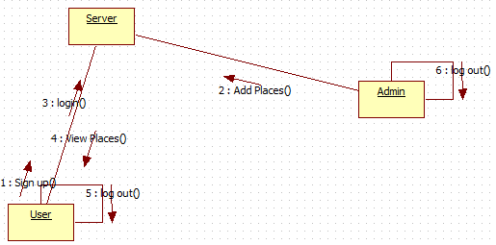
UML diagrams Collaboration

Slide 14
UML diagrams activity

Slide 15
UML diagrams Component

Slide 16
UML Diagrams Deployment

Slide 17
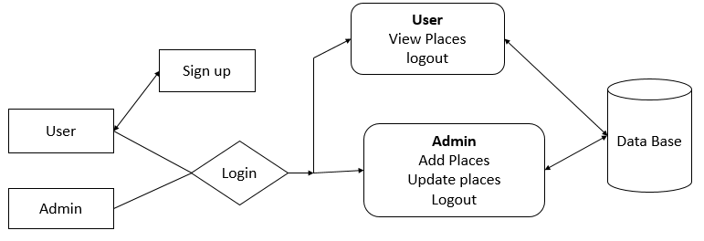
Block Diagram

Slide 18
Timeline of Project
Phase | REVIEW | Timeline
1.Title Finalization with Supervisor. | Review-0 | 16-10-23
2. Problem Definition/Novelty | Review-1 | 08-11-23
3. 50% implementation details | Review-2 | 28-11-23
4. 100% implementation details | Review-3 | 27-12-23
5. Demonstration | Final viva | 10-01-24

Slide 19
Expected Outcomes
This slide outlines the expected outcomes and deliverables of our project.
Development of a Dynamic Software Solution: Our project will result in the creation of a dynamic software solution for geographical route profiling.
Integration of Advanced Technologies: We will successfully integrate advanced Geographic Information Systems (GIS) and machine learning technologies into our software.
Real-Time Data Processing and Visualization: Our solution will enable real-time data processing and visualization, providing valuable insights for security agencies.
Enhanced Security and Surveillance: The project's outcomes will contribute to enhancing security and surveillance efforts along critical routes

Slide 20
Conclusion
Since travelling is one of the important aspect today, it is very necessary that proper planning need to be done beforehand in terms of safety management.
Most people without using the latest technology waste a lot of time just planning trips unsafe. So, an application like Geographical profiling application are really helps tourists to utilize their precious time to the fullest and also enjoy their trip at the same time.

Slide 21
References
[1]Application for e-Tourism: Intelligent Mobile Tourist Guide; Alexander Smirnov; Alexey Kashevnik; Andrew Ponomarev; Maksim Shchekotov; Kirill Kulakov, 16 July 2015
[2]SMART CITY TRAVELLER; Harshil Joshi, Shivani Chavan, Rinkal Patel, Abdullah Patel, May – 2019
[3]TOURGURU: Tour Guide Mobile Application for Tourists, M.S.B.W.T.M.P.S.B. Thennakoon; R.D.T.N. Rajarathna; S.P.B. Jayawickrama; M.P.D.S.M. Kumara, 07 December 2019
[4]Mobile Application for Tourist’s Personal Travelling Management in Kuala Lumpur; Nur Huda Mat Yusoff; Arulselvi Isvaramurty; Husniza Razalli, 07 October 2019
[5]Intelligent mobile based tourist assistance system; Rittwik Sood. 09 April 2017

Slide 22
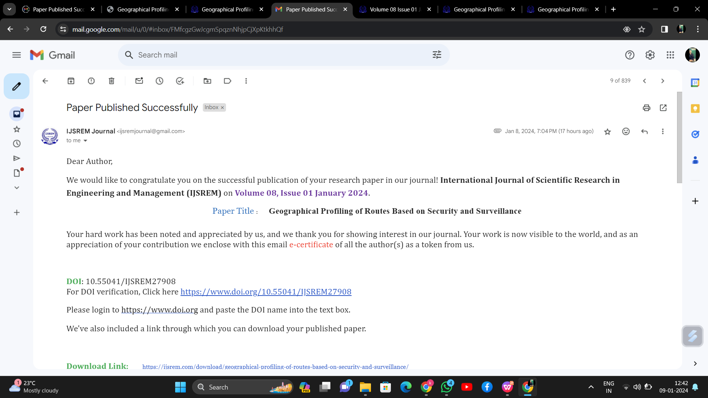
Publication Details

Slide 23

https://ijsrem.com/download/geographical-profiling-of-routes-based-on-security-and-surveillance/
By using this link or the QR Code,you will get the acesses to the published paper.

Slide 24
Thank You

